Slide 1
Secure Data Hiding in Image Using Steganography
CAPSTONE PROJECT
Presented By
Student Name : KALAIYARASAN G
College Name & Department : RMKCET & CSE(CYBER SECUCRITY)

Slide 2
OUTLINE
Problem Statement
Technology used
Wow factor
End users
Result
Conclusion
Git-hub Link
Future scope

Slide 3
Problem Statement
In today's digital world, secure communication is a major concern. Traditional encryption methods can be detected, leading to potential interception. Steganography offers a way to conceal data within images, making it less noticeable to attackers. This project focuses on implementing Least Significant Bit (LSB) steganography to securely hide and retrieve confidential information from images while maintaining image integrity.

Slide 4
Technology used
Libraries & Tools
Python – Main programming language for implementation.
OpenCV – For image processing and manipulation.
Stegano – A Python library for Least Significant Bit (LSB) steganography.
NumPy – For handling image arrays efficiently.
PyCryptodome – For AES encryption and decryption of hidden message
qrcode – For generating and decoding QR codes
Tkinter – For user-friendly GUI based file selection and input
Platforms
Linux/Windows – Compatible across operating systems.
VS Code – Used for writing and debugging code.

Slide 5
Wow factors
What Makes This Project Unique?
✅ Enhanced Security – Uses AES encryption along with LSB steganography, making hidden data highly secure and resistant to extraction. ✅ Multiple Data Hiding Options – Supports hiding text messages and entire files (PDF, TXT, etc.) inside images. ✅ QR Code Integration – Allows encoding and decoding hidden messages inside QR codes. ✅ User-Friendly Interface – GUI-based file selection with Tkinter, making it more accessible to users. ✅ Drag-and-Drop Support – Simplifies selecting images and files for steganography. ✅ Cross-Platform Compatibility – Works seamlessly on Windows and Linux. ✅ Future Expandability – Can be enhanced with multi-layer steganography, AI-based detection resistance, or steganography in videos and audio.

Slide 6
End users
Who Can Benefit from This Project?
👨‍💻 Cybersecurity Professionals – Use steganography for secure communication and covert data transfer.
🕵️ Digital Forensics Experts – Analyze hidden data in images for investigation purposes.
🔒 Privacy-Conscious Users – Protect personal or confidential information from prying eyes.
🏛 Government & Intelligence Agencies – Securely transmit sensitive data without drawing attention.
🎓 Students & Researchers – Learn and experiment with steganography techniques for academic purposes.

Slide 7
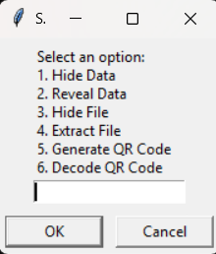
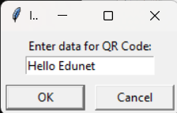
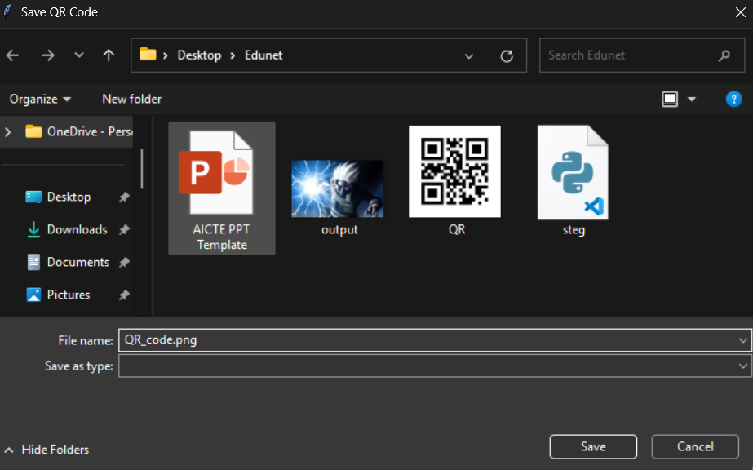
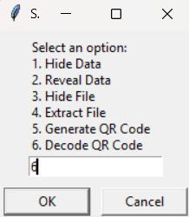
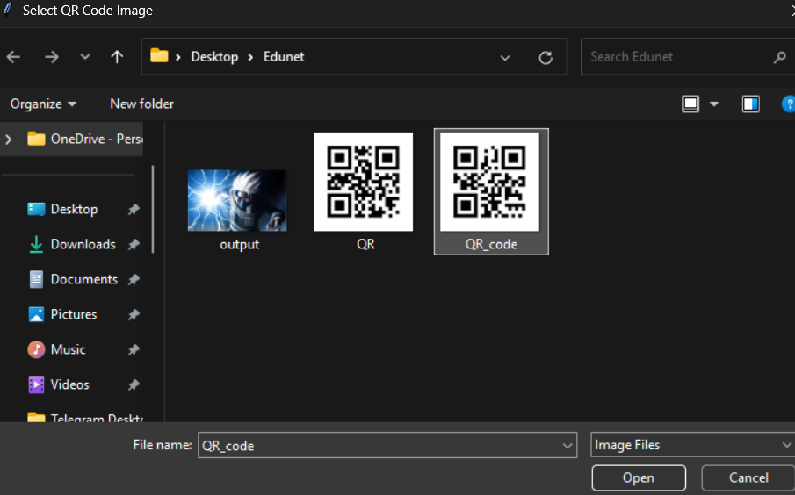

Results
I choose 5
Image saved
select Image
Decoded

Slide 8
Conclusion
Key Takeaways from the Project
✅ Advanced Data Hiding – Successfully implemented LSB-based image steganography with support for text, files, and QR codes. ✅ Enhanced Security – Integrated AES encryption, making hidden data more secure and resistant to extraction. ✅ Minimal Image Distortion – The embedded data does not visibly alter the original image, maintaining its integrity. ✅ User-Friendly & Efficient – Supports drag-and-drop functionality and a GUI-based approach for easy interaction. ✅ Secure & Versatile Communication – Allows covert messaging via QR codes, encrypted text, and hidden files.
This project highlights the effectiveness of steganography for secure data transmission. Future enhancements could include multi-layer encryption, AI-based steganalysis resistance, and support for video/audio steganography to further improve security and usability.

Slide 9
GitHub Link
https://github.com/BLACKYDOMAIN/Secure-Image-Steganography

Slide 10
THANK YOU

